Slide 1



Planning Actions for Continuous Improvement in Taskstream
Summer 2020 Workshop: Taskstream Series #8
presented by: Mary Elizabeth Spence
July 27, 2020
AState.edu
/ArkansasState
@ArkansasState

Slide 2



Workshop Procedures
Welcome and thank you for participating in our Summer Workshop Series!
You will be muted upon entry to the workshop, so please introduce yourself via the Chat feature by clicking “Chat.”
The window to the right will appear where you can add your introduction:
If you have questions during the session, please add them to the Chat box and at the conclusion of our time we will include them in the Q and A.
AState.edu
/ArkansasState
@ArkansasState

Slide 3
Workshop Agenda
Attendees will be able to:
Create “New Operational Plan” in Taskstream per Annual Cycle
Accurately and thoroughly report all aspects of action planning, including:
  Action Summary
  Implementation Timeline
  Responsible Personnel
  Priority Level to Leadership
AState.edu
/ArkansasState
@ArkansasState

Slide 4
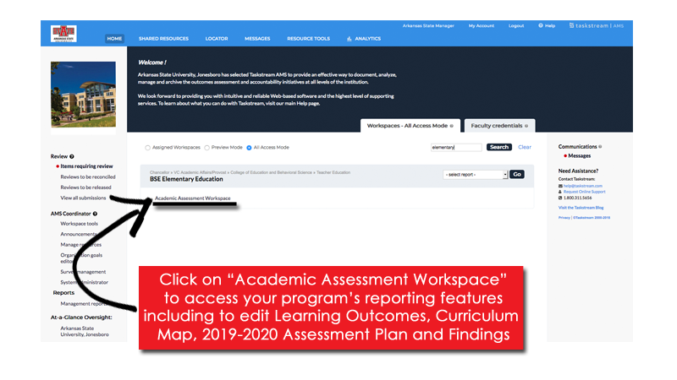

Taskstream Welcome Screen
This screen will show any Programs that you have access to view/edit.
AState.edu
/ArkansasState
@ArkansasState

Slide 5
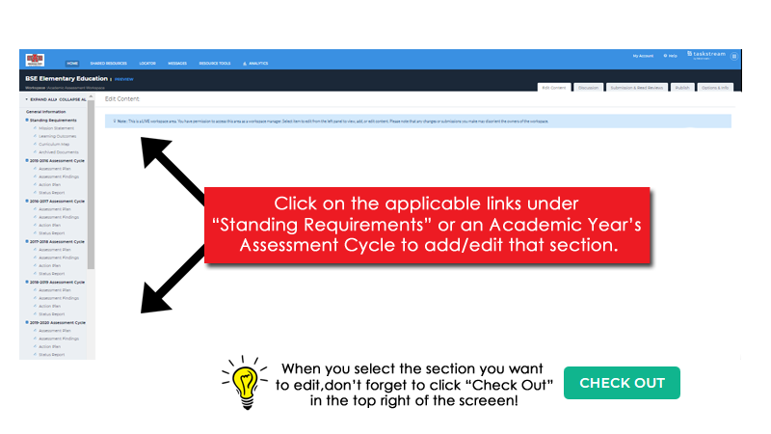
Workspace Landing Screen
This is the initial screen you will see when you select a Workspace.
AState.edu
/ArkansasState
@ArkansasState

Slide 6
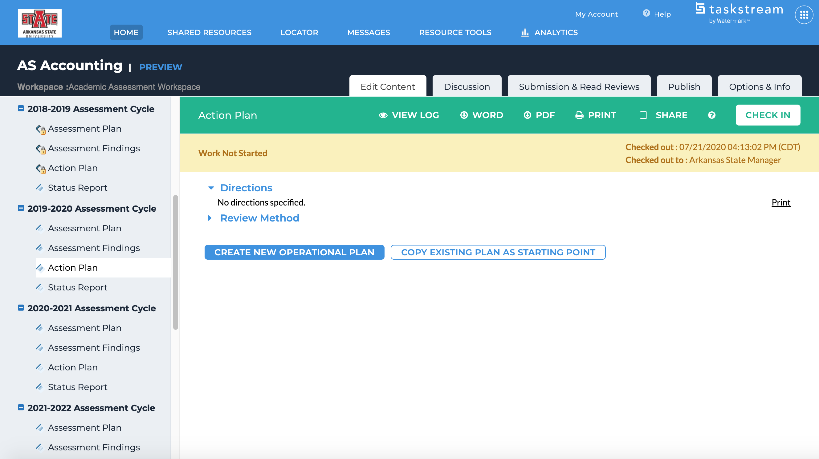
Action Plan
Click on “Action Plan” on the Left Toolbar
AState.edu
/ArkansasState
@ArkansasState

Slide 7
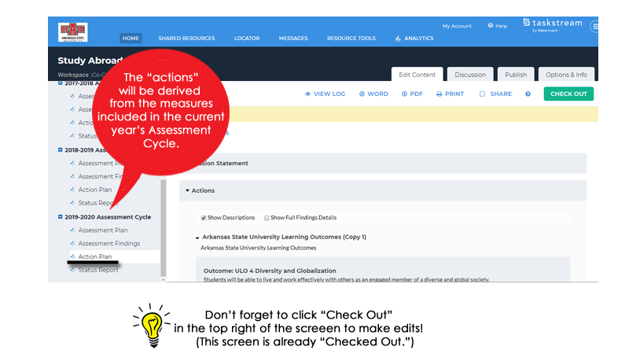
Action Plan
Click on “Action Plan” on the Left Toolbar
AState.edu
/ArkansasState
@ArkansasState

Slide 8
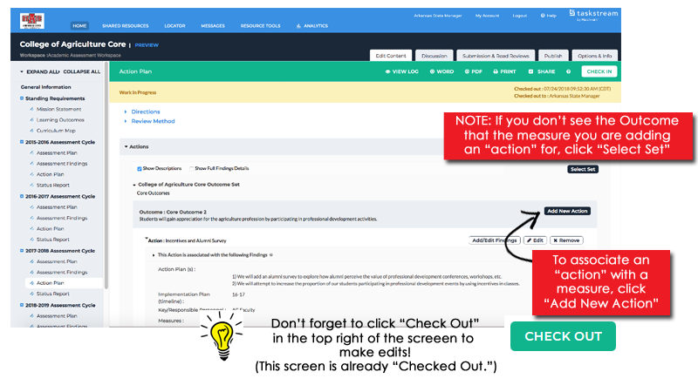
Action Plan
Actions are associated with Measures entered in the Assessment Plan
AState.edu
/ArkansasState
@ArkansasState

Slide 9
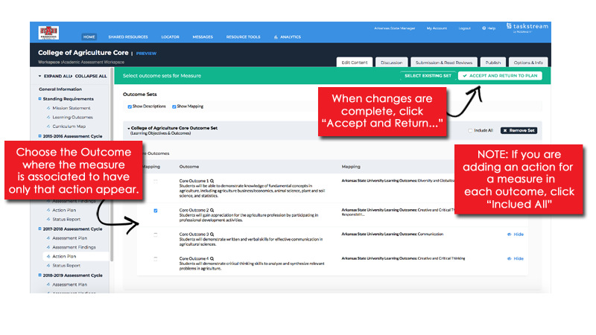
Action Plan
Follow the steps below to choose the applicable Outcomes by year
AState.edu
/ArkansasState
@ArkansasState

Slide 10
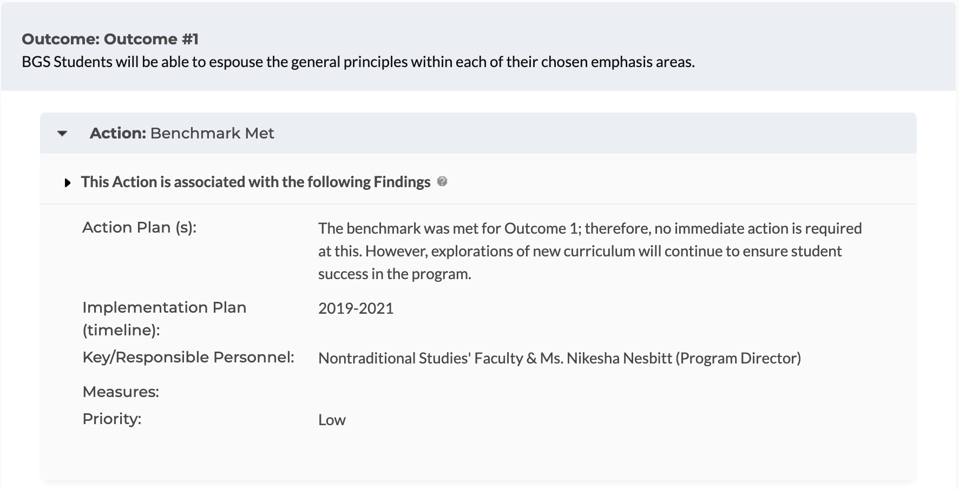
Action Plan
Examples:
AState.edu
/ArkansasState
@ArkansasState

Slide 11
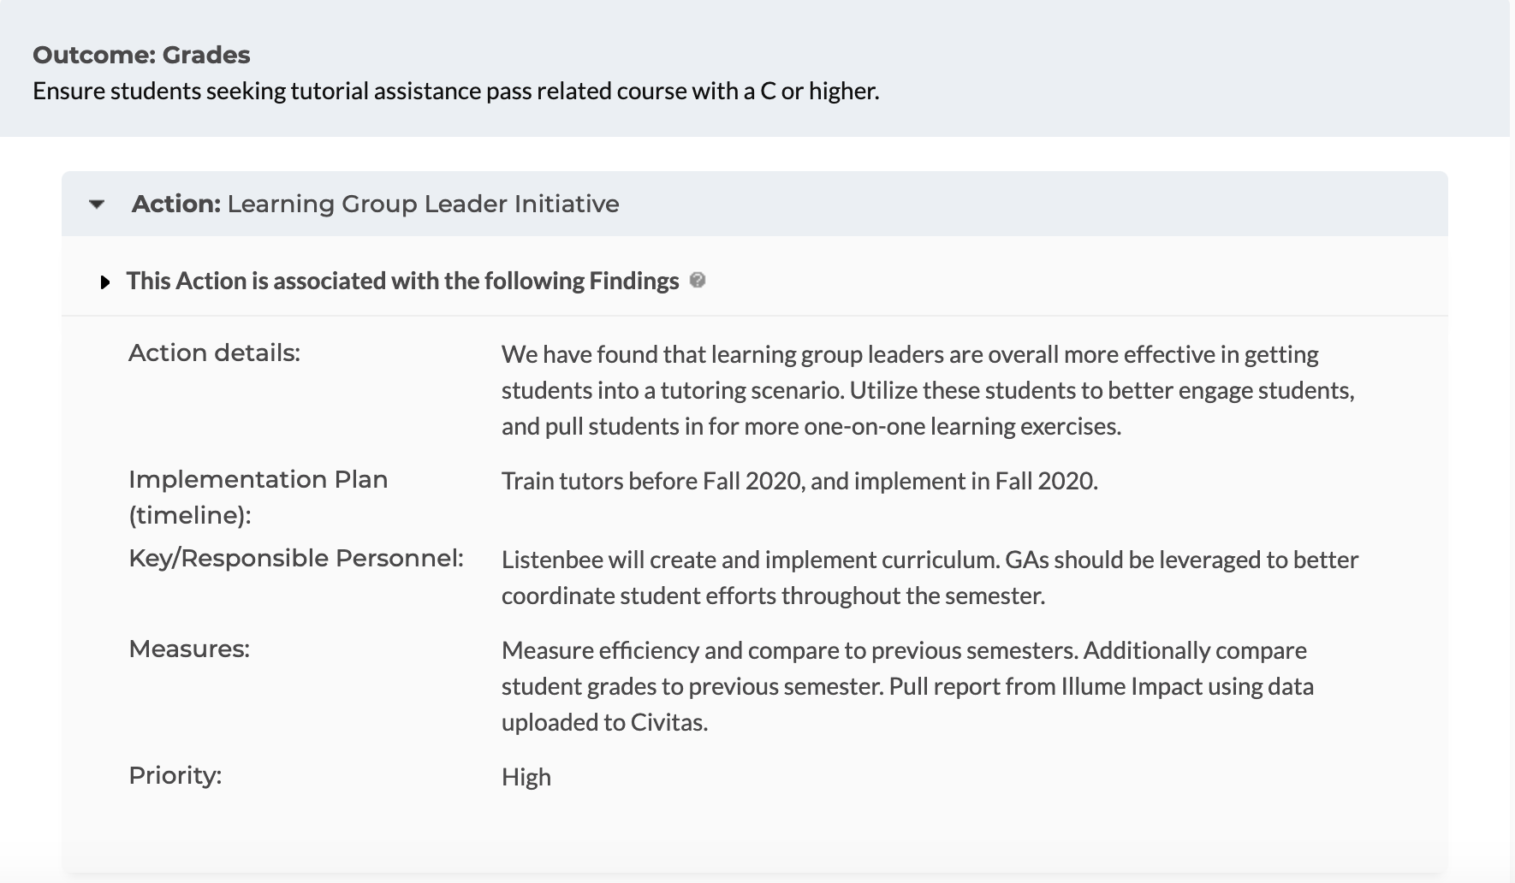
Action Plan
Examples:
AState.edu
/ArkansasState
@ArkansasState

Slide 12
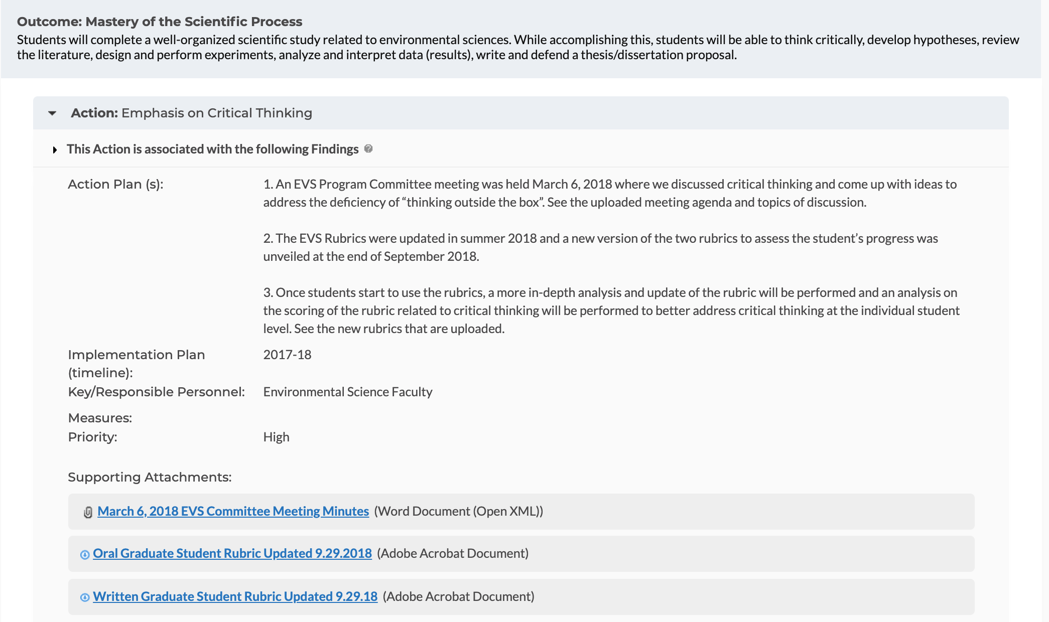
Action Plan
Examples:
AState.edu
/ArkansasState
@ArkansasState

Slide 13
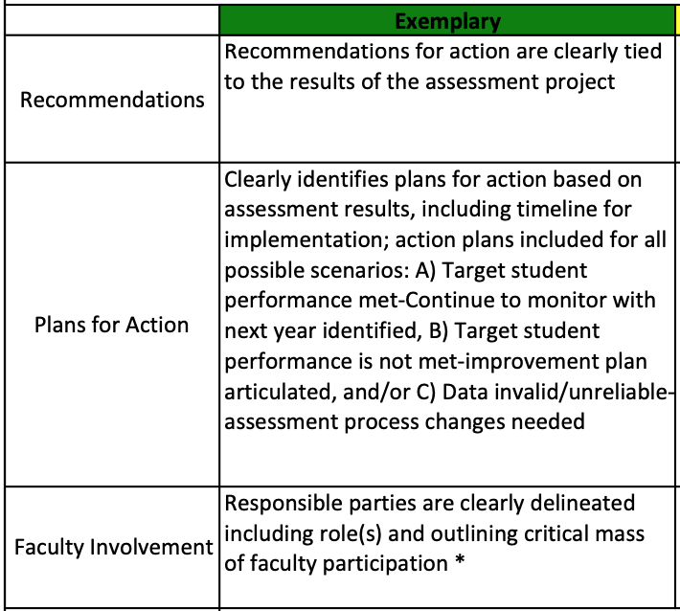
Action Plan Reporting Tips
Recommendations, Plans for Action and Faculty Involvement
-For best practice, the Action Plan should be tied directly to the results of the Assessment Findings. Findings most often fall into 3 “buckets:”
1.) Assessment process and student learning is deemed “good” by faculty and leaders and no action needs to be taken at this time. Please articulate this in the Action Plan.
2.) Student learning is deemed poor and the Action Plan details how this will be addressed.
3.) Nothing of note can be taken away from the Findings, because the process is poor, and the Action Plan details how this will be corrected or changed.
-Please identify faculty directly involved in the Action going to be taken. Be as specific as possible. * Please provide more information than simply stating "faculty."
-Please refer to the graphic below for “Exemplary” action plan reporting suggestions (For the Peer Review rubric in totality, please see attachment to this email.):
AState.edu
/ArkansasState
@ArkansasState

Slide 14
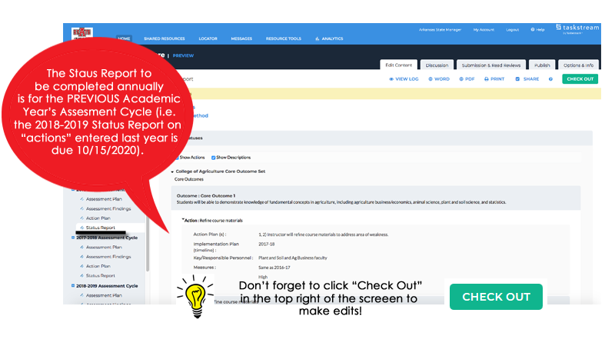
Status Report
The Status Report is an update of the progress of the previous year’s Actions.
AState.edu
/ArkansasState
@ArkansasState

Slide 15
Status Report Reporting Tips
Status of Previous Year’s Action Plan
-The Status Report is where an update on the actions taken from the previous year’s plan should be documented. The three “buckets” of an Action Plan are detailed again below.
-Please refer to the graphic below for “Exemplary” assessment findings reporting suggestions (For the Peer Review rubric in totality, please see attachment to this email.):
AState.edu
/ArkansasState
@ArkansasState

Slide 16

Session Q & A
AState.edu
/ArkansasState
@ArkansasState

Slide 17

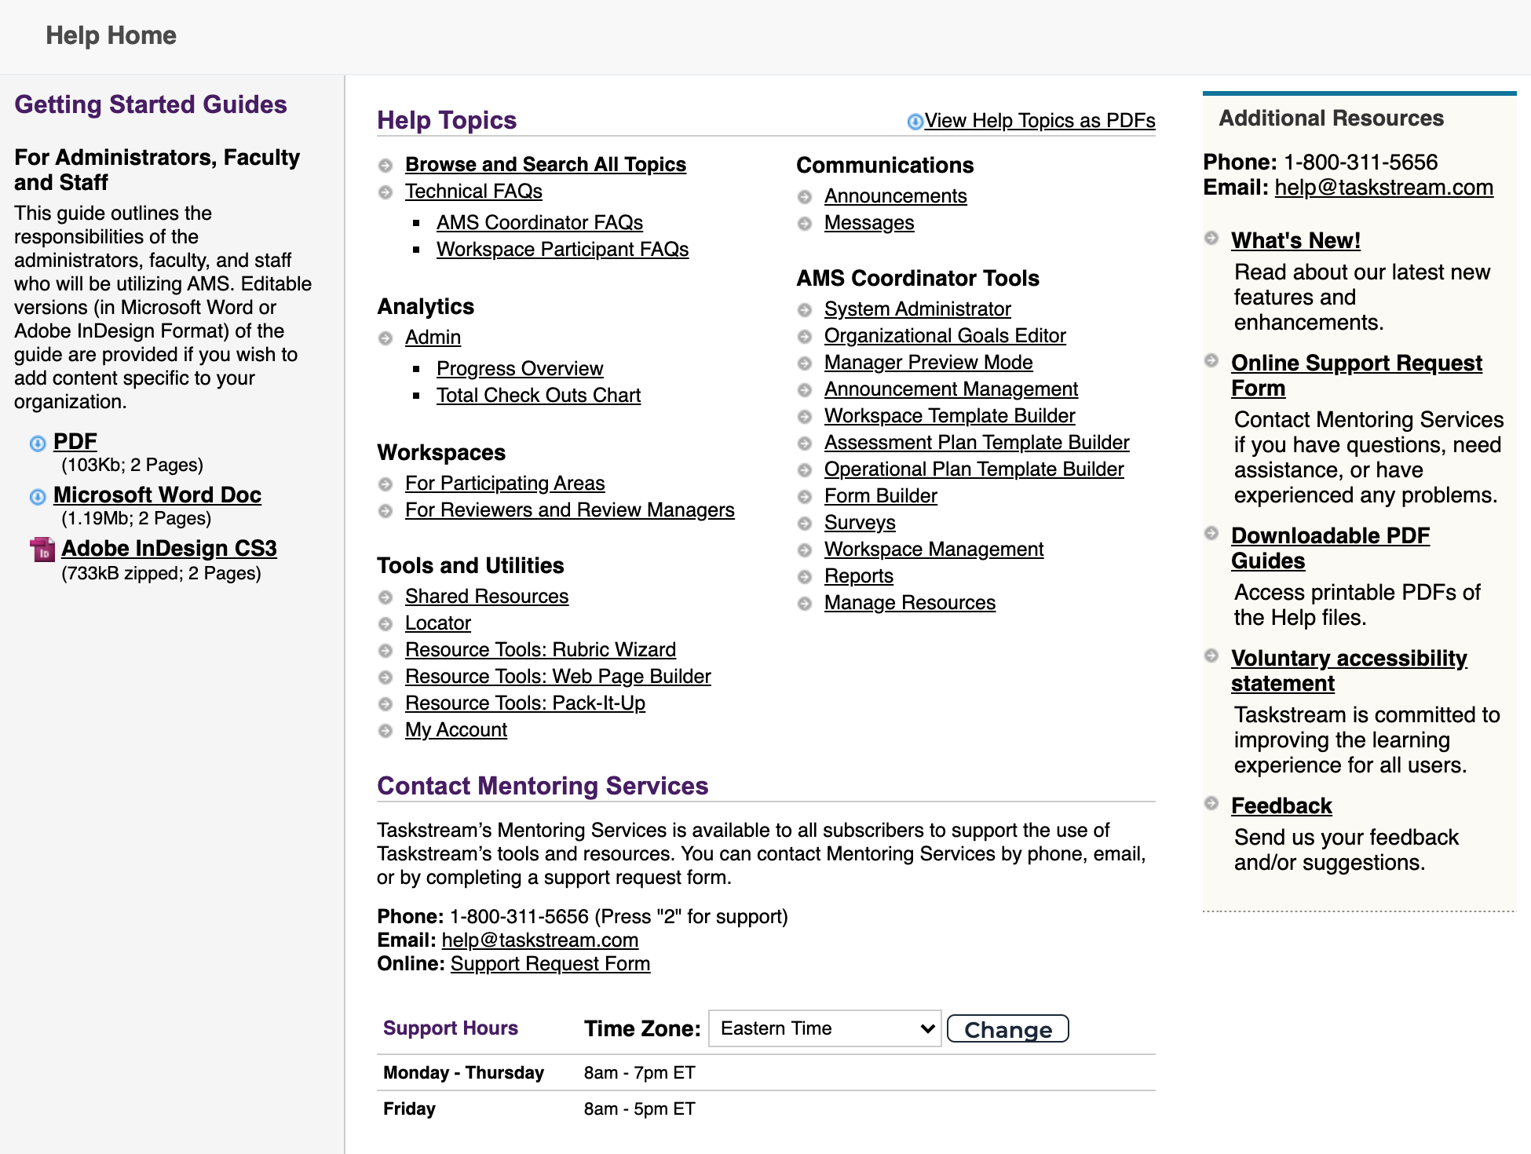
Taskstream Help
For “after hours” assistance, Taskstream has a number of great resources including contact by email and phone and a substantial set of guides. All can be accessed by clicking “? Help”:
AState.edu
/ArkansasState
@ArkansasState

